Slide 1
SPRING CORE & DI
August 31, 2016

Slide 2
Introduction to Spring
Spring Overview
Advantage of Spring
Architecture of Spring
Core Container
Spring Container
Spring IOC Container
BeanFactory container
ApplicationContext container
Bean Definition
XML based configuration
Annotation based configuration
Bean Scopes
Introduction
Bean Lifecycle
Bean Postprocessor

Slide 3
Objectives
understanding of Spring framework.
Working of Spring container and inversion of Control(IOC)
Spring Beans configuration
Bean Scopes
Dependency Injection
Event Handling

Slide 4
Spring Overview
Spring Framework is a Java platform that provides comprehensive infrastructure support for developing Java applications. Spring handles the infrastructure so you can focus on your application.
Spring enables you to build applications from "plain old Java objects" (POJOs) and to apply enterprise services non-invasively to POJOs.
Spring is designed to be non-intrusive, meaning that your domain logic code generally has no dependencies on the framework itself.
Key Features :
Lightweight framework
Modular
Dependency Injection
IOC container
Aspect Oriented

Slide 5
Advantage of Spring
Works on POJOs. Hence easier for dependency injection / injection of test data.
With the Dependency Injection(DI) approach, dependencies are explicit and evident in constructor or JavaBean properties
Enhances modularity. Provides more readable codes.
Provides loose coupling between different modules.
Flexible use of Dependency injection. Can be configured by XML based schema or annotation-based style.
Supports declarative transaction, caching, validation and formatting.
Boilerplate reduction through aspects and templates.
Spring comes with some of the existing technologies like ORM framework, logging framework, J2EE and JDK Timers etc, Hence we don’t need to integrate explicitly those technologies.
Spring WEB framework has a well-designed web MVC framework, which provides a great alternate to web framework.
Spring framework has taken the best practice that have been proven over the years in several applications and formalized as design patterns.

Slide 6
Architecture of Spring
The Spring Framework consists of features organized into about 20 modules. These modules are grouped into Core Container, Data Access/Integration, Web, AOP (Aspect Oriented Programming), Instrumentation and Test

Slide 7
Architecture contd…
Core Container
The core container is the heart of Spring framework and all other modules are built on top of it. It provides the dependency injection feature, also is known as inversion of control. This module contains the BeanFactory (an implementation of factory pattern) which creates and manages the life cycle of the various application objects (known as beans) defined in the Spring bean configuration file.
AOP
This module helps in implementing the various cross cutting concerns in the application like logging, transaction management etc. These concerns are decoupled from the application code and are injected into the various point cuts through configuration file.
Spring Web
Spring framework helps in developing web based application by providing the Spring web module. This module is built on top of application context module and provides web oriented features. Spring MVC module is built on top of Spring web module and helps in developing web application based on MVC design pattern.
Spring DAO
Almost every enterprise application needs to interact with the database. Spring DAO module makes it easy to interact with database by providing an abstraction over low level JDBC tasks like creating a database connection, release it etc.
Spring ORM
There exist a number of popular object-relational mapping tools like Hibernate, iBatis, JPA etc. Spring ORM module helps in integrating with these tools.

Slide 8
Core container
The Core Container consists of the Core, Beans, Context, and Expression Language modules.
The Core and Beans modules provide the fundamental parts of the framework, including the IoC and Dependency Injection features. The BeanFactory is a sophisticated implementation of the factory pattern. It removes the need for programmatic singletons and allows you to decouple the configuration and specification of dependencies from your actual program logic.
The Context module builds on the solid base provided by the Core and Beans modules: it is a means to access objects in a framework-style manner that is similar to a JNDI registry. The Context module inherits its features from the Beans module and adds support for internationalization (using, for example, resource bundles), event-propagation, resource-loading, and the transparent creation of contexts by, for example, a servlet container. The Context module also supports Java EE features such as EJB, JMX ,and basic remoting. The ApplicationContext interface is the focal point of the Context module.
The Expression Language module provides a powerful expression language for querying and manipulating an object graph at runtime. It is an extension of the unified expression language (unified EL) as specified in the JSP 2.1 specification. The language supports setting and getting property values, property assignment, method invocation, accessing the context of arrays, collections and indexers, logical and arithmetic operators, named variables, and retrieval of objects by name from Spring’s IoC container

Slide 9
Spring IOC Container
The Spring container is at the core of the Spring Framework. The container will create the objects, wire them together, configure them, and manage their complete lifecycle from creation till destruction. It is the implementation of Inversion of Control (IOC) principle.
IoC is also known as dependency injection (DI). It is a process whereby objects define their dependencies, that is, the other objects they work with, only through constructor arguments, arguments to a factory method, or properties that are set on the object instance after it is constructed or returned from a factory method.
The container then injects those dependencies when it creates the bean. This process is fundamentally the inverse, hence the name Inversion of Control (IoC), of the bean itself controlling the instantiation or location of its dependencies by using direct construction of classes, or a mechanism such as the Service Locator pattern.
The container gets its instructions on what objects to instantiate, configure, and assemble by reading configuration metadata provided. The configuration metadata can be represented either by XML, Java annotations, or Java code.
Spring provides following two distinct types of containers.
BeanFactory container
ApplicationContext container

Slide 10
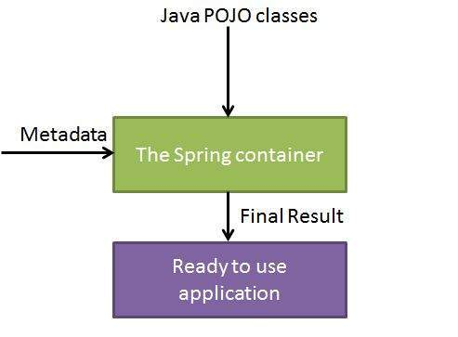
IOC container contd…
The Spring IoC container makes use of Java POJO classes and configuration metadata to produce a fully configured and executable system or application.

Slide 11
BeanFactory container
This is the simplest container providing basic support for DI and defined by the org.springframework.beans.factory.BeanFactory interface. A BeanFactory is essentially nothing more than the interface for an advanced factory capable of maintaining a registry of different beans and their dependencies.
There are a number of implementations of the BeanFactory interface that come supplied straight out-of-the-box with Spring. The most commonly used BeanFactory implementation is the XmlBeanFactory class. This container reads the configuration metadata from an XML file and uses it to create a fully configured system or application.
The BeanFactory is usually preferred where the resources are limited like mobile devices or applet based applications.
To explain the concept we have created following 3 files :
HelloWorld.java : Simple Java POJO having just a getter and setter
MainApp.java : Creates a BeanFactory and gets HelloWorld bean
Beans.xml : XML bean configuration file

Slide 12
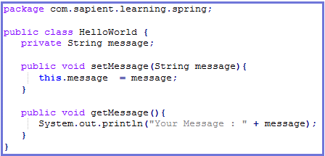
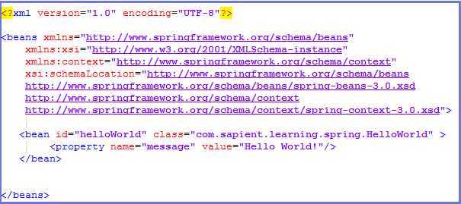
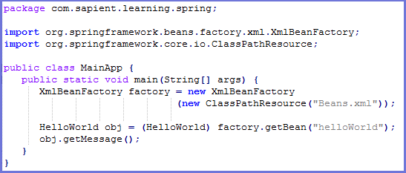
BeanFactory container contd…
HelloWorld.java
Beans.xml
MainApp.java

Slide 13
ApplicationContext container
The Application Context is spring's more advanced container. Similar to BeanFactory it can load bean definitions, wire beans together and dispense beans upon request.
Additionally it adds more enterprise-specific functionality such as the ability to resolve textual messages from a properties file and the ability to publish application events to interested event listeners.
The ApplicationContext includes all functionality of the BeanFactory, it is generally recommended over the BeanFactory.
The most commonly used ApplicationContext implementations are:
FileSystemXmlApplicationContext: This container loads the definitions of the beans from an XML file. Here you need to provide the full path of the XML bean configuration file to the constructor.
ClassPathXmlApplicationContext This container loads the definitions of the beans from an XML file. Here you do not need to provide the full path of the XML file but you need to set CLASSPATH properly because this container will look bean configuration XML file in CLASSPATH.
WebXmlApplicationContext: This container loads the XML file with definitions of all beans from within a web application.
To explain the concept we have created following 3 files :
HelloWorld.java : Simple Java POJO having just a getter and setter
MainApp.java : Creates a FileSystemXMLApplicationContext and gets HelloWorld bean
Beans.xml : XML bean configuration file

Slide 14
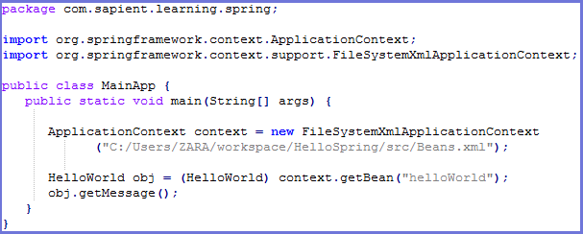
ApplicationContext container contd…
HelloWorld.java
Beans.xml
MainApp.java

Slide 15
BeanFactory vs ApplicationContext container
Feature | BeanFactory | ApplicationContext
Bean instantiation/wiring | Yes | Yes
Automatic BeanPostProcessor registration | No | Yes
Automatic BeanFactoryPostProcessor registration | No | Yes
Convenient MessageSource access (for i18n) | No | Yes
ApplicationEvent publication | No | Yes

Slide 16
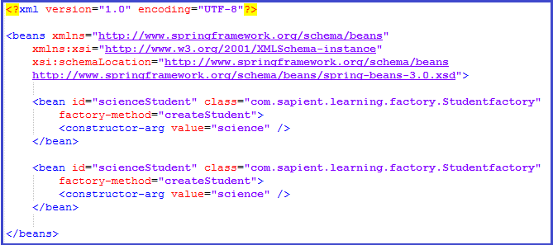
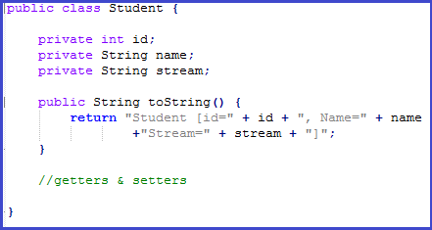
Factory Method
Normally, Spring instantiates a class and performs dependency injection. However, sometimes it may be necessary to instantiate a class via another class
In such a scenario, Spring should not create the class on its own but simply delegate the instantiation to the Factory class.
Spring provides a way to delegate class instantiation to another class by using factory-method attribute of bean tag
Beans.xml
Student.java

Slide 17
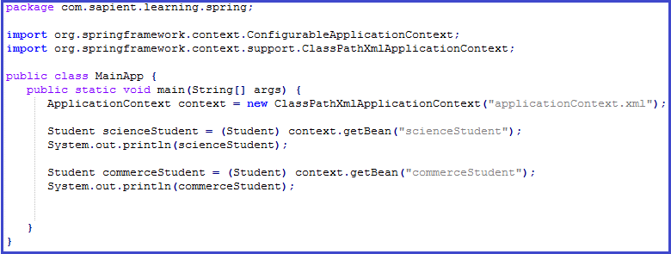
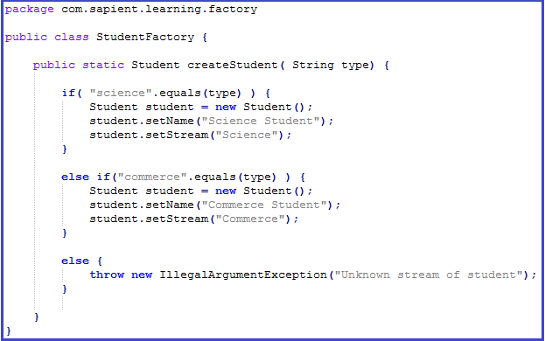
Factory Method contd…
MainApp.java
StudentFactory.java

Slide 18
Exercise
Create a student bean which has a reference to other beans like address etc. and other fields as well.
Create a sample Spring application using BeanFactory having these POJO’s and configure the main application to display details of a particular student based on name and id.
Repeat the same using ApplicationContext.
Repeat the same by creating a Factory method.

Slide 19
Bean Definition
The objects that form the backbone of your application and that are managed by the Spring IoC container are called beans. A bean is an object that is instantiated, assembled, and otherwise managed by a Spring IoC container.
These beans are created with the configuration metadata that you supply to the container, for example, in the form of XML <bean/> definitions which you have already seen in previous slides.
The bean definition contains the information called configuration metadata which is needed for the container to know the following :
How to create a bean
Bean's lifecycle details
Bean's dependencies
All the above configuration metadata translates into a set of the following properties that make up each bean definition :
class : This attribute is mandatory and specify the bean class to be used to create the bean.
name : This attribute specifies the bean identifier uniquely. In XML-based configuration metadata, you use the id and/or name attributes to specify the bean identifier(s).
scope : This attribute specifies the scope of the objects created from a particular bean definition
constructor-arg/properties/autowiring mode : This is used to inject the dependencies
lazy-initialization mode : A lazy-initialized bean tells the IoC container to create a bean instance when it is first requested, rather than at startup.
initialization method : A callback to be called just after all necessary properties on the bean have been set by the container
destruction method : A callback to be used when the container containing the bean is destroyed

Slide 20
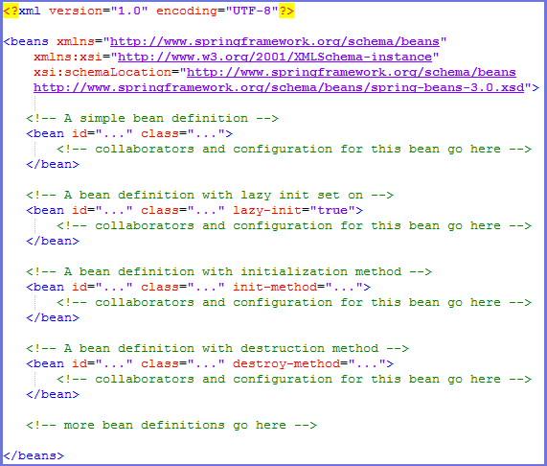
XML based configuration
Following is a sample XML based configuration file with different bean definitions including lazy initialization, initialization method and destruction method:

Slide 21
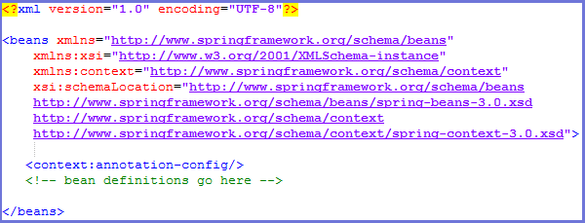
Annotation based configuration
Starting from Spring 2.5 it became possible to configure the dependency injection using annotations. So instead of using XML to describe a bean wiring, you can move the bean configuration into the component class itself by using annotations on the relevant class, method, or field declaration.
Annotation injection is performed before XML injection, thus the latter configuration will override the former for properties wired through both approaches.
Annotation wiring is not turned on in the Spring container by default. So, before we can use annotation-based wiring, we will need to enable it in our Spring configuration file. So consider to have following configuration file in case you want to use any annotation in your Spring application.

Slide 22
Annotation based configuration contd…
Once <context:annotation-config/> is configured, you can start annotating your code to indicate that Spring should automatically wire values into properties, methods, and constructors.
Following are a few important annotations :
@Required : The @Required annotation applies to bean property setter methods.
@Autowired : The @Autowired annotation can apply to bean property setter methods, non-setter methods, constructor and properties.
@Qualifier : The @Qualifier annotation along with @Autowired can be used to remove the confusion by specifiying which exact bean will be wired.
JSR-250 Annotations : Spring supports JSR-250 based annotations which include @Resource, @PostConstruct and @PreDestroy annotations.

Slide 23
@Required annotation
The @Required annotation applies to bean property setter methods and it indicates that the affected bean property must be populated in XML configuration file at configuration time otherwise the container throws a BeanInitializationException exception.
To explain the concepts with example we will take one use case. Consider a Student Management system which maintains records of students enrolled in a college. This use case will be used in all the examples.
To explain @Required annotation the following 3 files are there :
Student.java : It has 2 fields-age & name and getters & setters.
MainApp.java : gets student bean and prints name & age
Beans.xml : spring configuration file

Slide 24
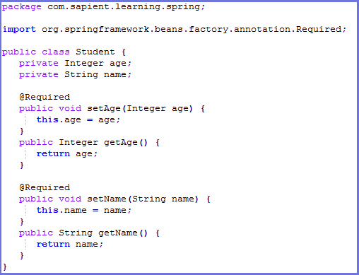
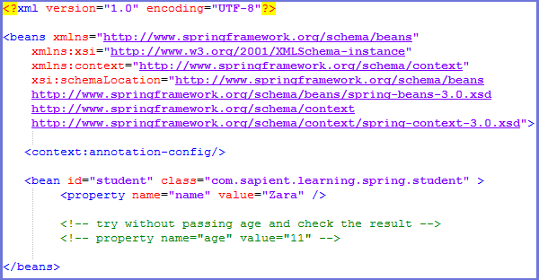
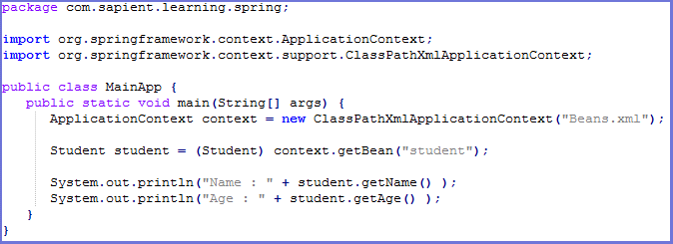
@Required annotation contd…
Student.java
Beans.xml
MainApp.java

Slide 25
@Autowired Annotation
The @Autowired annotation can be used to autowire bean on the setter method just like @Required annotation, constructor, a property or methods with arbitrary names and/or multiple arguments.
When Spring finds an @Autowired annotation used with setter methods, it tries to perform byType autowiring on the method.
The @Autowired annotation can be applied on setters, properties & constructors.
By default, the @Autowired annotation implies the dependency is required similar to @Required annotation, however, you can turn off the default behavior by using (required=false) option with @Autowired.
To explain @Autowired annotation the following 5 files are there :
Student.java : It has 2 fields-age & name and getters & setters.
Address.java : It stores student address and is a POJO
Subject.java : It stores student’s subject and is a POJO
MainApp.java : gets student bean and prints name & age
Beans.xml : spring configuration file which includes all the possible places where we can have @Autowired annotation

Slide 26
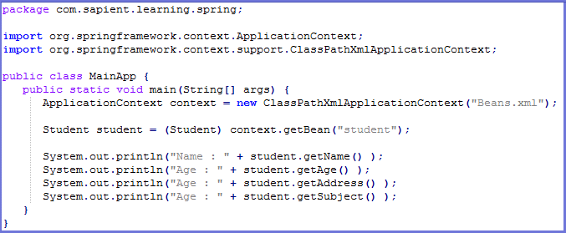
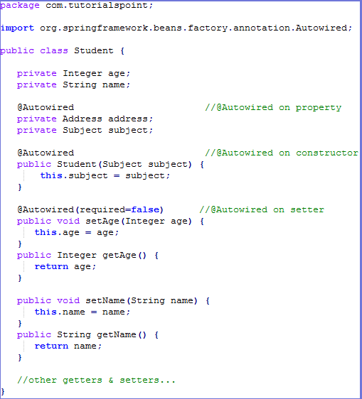
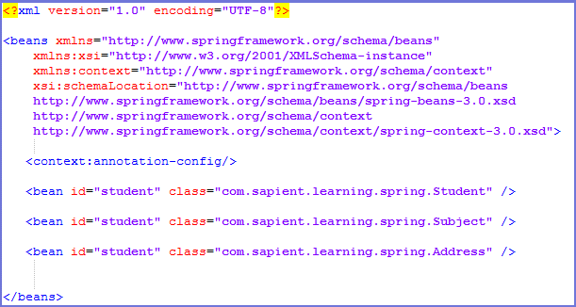
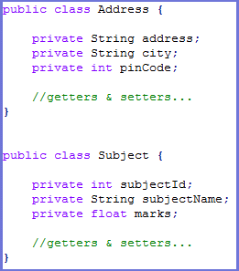
@Autowired annotation contd…
MainApp.java
Student.java
Beans.xml
POJO’s

Slide 27
@Qualifier annotation
There may be a situation when you create more than one bean of the same type and want to wire only one of them with a property, in such case you can use @Qualifier annotation along with @Autowired to remove the confusion by specifying which exact bean will be wired.
To explain @Qualifier annotation the following 4 files are there :
Student.java : It has 2 fields-age & name and getters & setters.
Profile.java : It has dependency on Student object which is resolved using @Qualifier annotation
MainApp.java : gets student bean and prints name & age
Beans.xml : spring configuration file

Slide 28
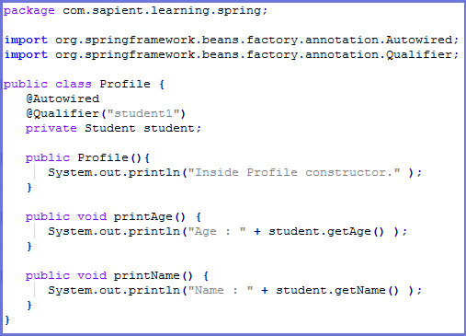
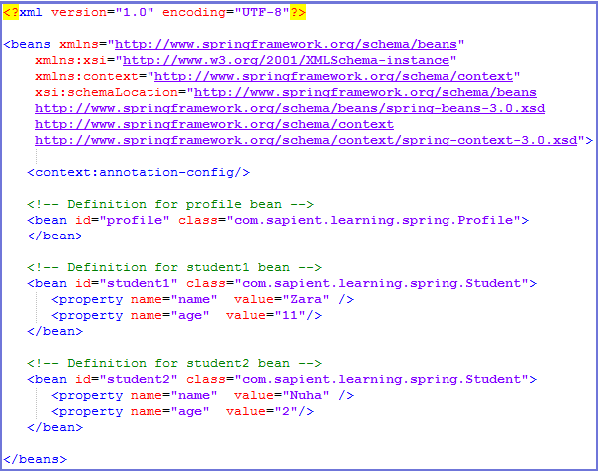
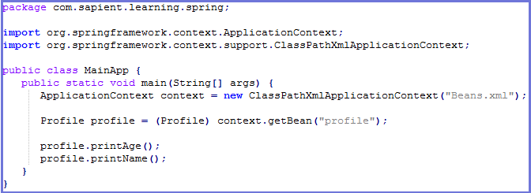
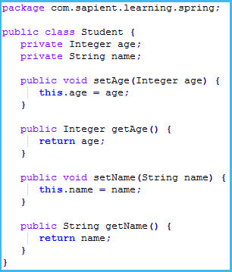
@Qualifier annotation contd…
Profile.java
Beans.xml
MainApp.java
Student.java

Slide 29
Exercise
Modify the sample Student application created earlier to configure the beans using annotation.
Use @Required in id and name and try to define beans with/without the mandatory fields and observe the exception.
Use @Autowired annotation to wire the beans
Use @Qualifier to mark 2 or more address beans that belong to a particular student and display the address details.

Slide 30
Bean Scopes
When defining a <bean> in Spring, you have the option of declaring a scope for that bean.
The Spring Framework supports following five scopes, three of which are available only if you use a web-aware ApplicationContext.
singleton : This scopes the bean definition to a single instance per Spring IoC container (default)
prototype : This scopes a single bean definition to have any number of object instances.
request : This scopes a bean definition to an HTTP request. Only valid in the context of a web-aware Spring ApplicationContext.
session : This scopes a bean definition to an HTTP session. Only valid in the context of a web-aware Spring ApplicationContext.
global-session : This scopes a bean definition to a global HTTP session. Only valid in the context of a web-aware Spring ApplicationContext.

Slide 31
Singleton scope
If scope is set to singleton, the Spring IoC container creates exactly one instance of the object defined by that bean definition. The default scope is singleton.
This single instance is stored in a cache of such singleton beans, and all subsequent requests and references for that named bean return the cached object.
Spring’s concept of a singleton bean differs from the Singleton pattern as defined in the Gang of Four (GoF) patterns book. The GoF Singleton hard-codes the scope of an object such that one and only one instance of a particular class is created per ClassLoader.
The scope of the Spring singleton is best described as per container and per bean. This means that if you define one bean for a particular class in a single Spring container, then the Spring container creates one and only one instance of the class defined by that bean definition.
To explain the concept further the following 3 files are there :
Student.java : It has 2 fields-age & name and getters & setters.
MainApp.java : gets student bean and prints name
Beans.xml : spring configuration file

Slide 32
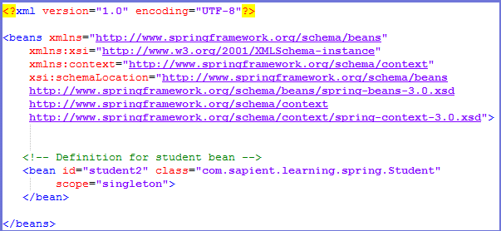
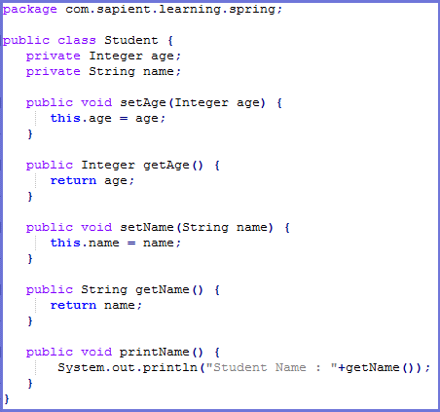
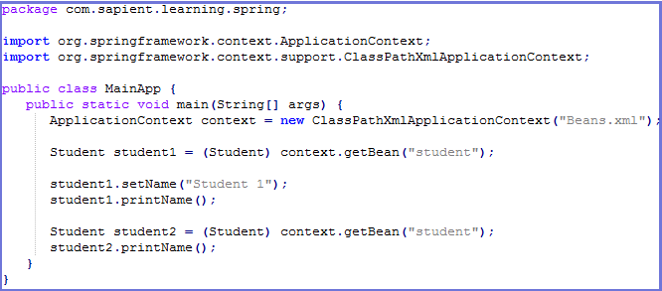

Singleton scope contd…
Beans.xml
Student.java
MainApp.java
Output

Slide 33
Prototype scope
If scope is set to prototype, the Spring IoC container creates new bean instance of the object every time a request for that specific bean is made.
As a rule, use the prototype scope for all state-full beans and the singleton scope for stateless beans.
To explain the concept further the following 3 files are there :
Student.java : It has 2 fields-age & name and getters & setters.
MainApp.java : gets student bean and prints name
Beans.xml : spring configuration file

Slide 34
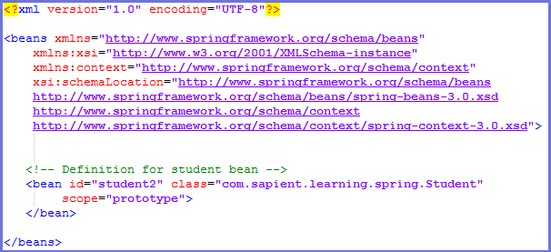

Prototype scope contd…
Beans.xml
Student.java
MainApp.java
Output

Slide 35
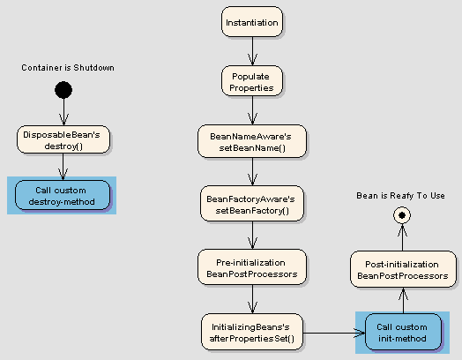
Bean Lifecycle
Spring bean factory is responsible for managing the life cycle of beans created through spring container. The life cycle of beans consist of call back methods which can be categorized broadly in two groups:
Post initialization call back methods
Pre destruction call back methods

Slide 36
Bean Lifecycle contd…
Spring framework provides following 4 ways for controlling life cycle events of bean:
InitializingBean and DisposableBean callback interfaces
Other Aware interfaces for specific behavior
custom init() and destroy() methods in bean configuration file
@PostConstruct and @PreDestroy annotations

Slide 37
Bean Lifecycle use case
The use case to explain Spring Bean lifecycle is Student bean which has init & destroy methods.
The init method is used to define student data like id, name etc. whenever a bean is requested.
The destroy method is used to close DB connections and other IO connections that were opened during the bean lifetime.
The same use case is valid for all types of bean lifecycle variations like init-destroy method, @PostConstruct-@preDestroy and InitializingBean-DisposableBean interfaces.

Slide 38
InitializingBean & DisposableBean callback interfaces
The org.springframework.beans.factory.InitializingBean interface specifies a single method:
void afterPropertiesSet() throws Exception;
The org.springframework.beans.factory.DisposableBean interface specifies a single method:
void destroy() throws Exception;
Note : If you are using Spring's IoC container in a non-web application environment; for example, in a rich client desktop environment; you register a shutdown hook with the JVM. Doing so ensures a graceful shutdown and calls the relevant destroy methods on your singleton beans so that all resources are released.

Slide 39
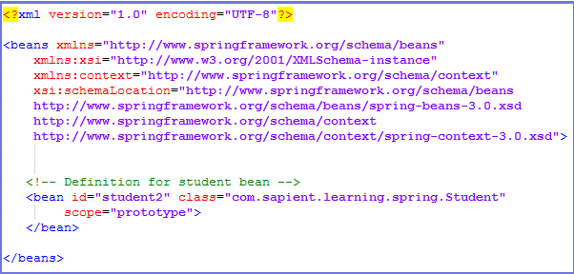
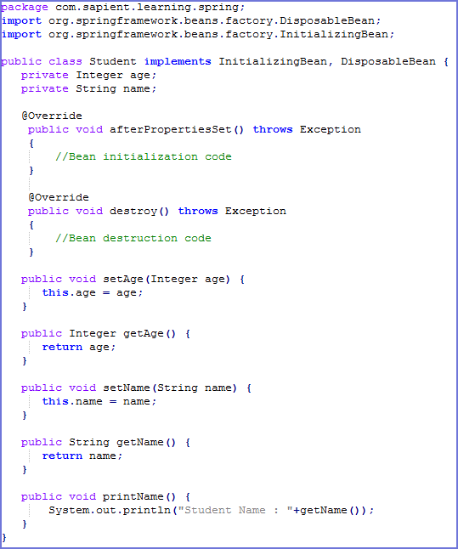
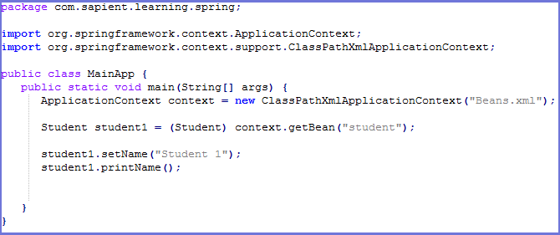
InitializingBean & DisposableBean callback interfaces contd…
Beans.xml
Student.java
MainApp.java

Slide 40
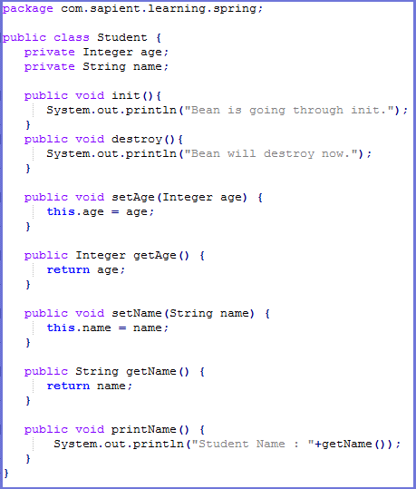
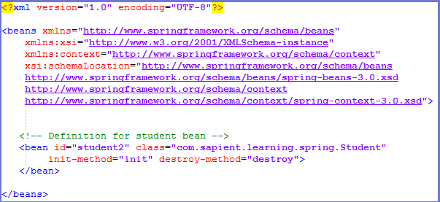
Custom init & destroy methods
In the case of XML-based configuration metadata, you can use the init-method attribute to specify the name of the method that has a void no-argument signature.
Similarly you can use the destroy-method attribute to specify the name of the method that has a void no-argument signature.
Student.java
Beans.xml

Slide 41
Aware interfaces…
Aware interface | Method to override | Purpose
ApplicationContextAware | void setApplicationContext(ApplicationContext applicationContext) throws BeansException; | Interface to be implemented by any object that wishes to be notified of the ApplicationContext that it runs in.
ApplicationEventPublisherAware | void setApplicationEventPublisher(ApplicationEventPublisher applicationEventPublisher); | Set the ApplicationEventPublisher that this object runs in.
BeanClassLoaderAware | void setBeanClassLoader(ClassLoader classLoader); | Callback that supplies the bean class loader to a bean instance.
BeanFactoryAware | void setBeanFactory(BeanFactory beanFactory) throws BeansException; | Callback that supplies the owning factory to a bean instance.
BeanNameAware | void setBeanName(String name); | Set the name of the bean in the bean factory that created this bean.
BootstrapContextAware | void setBootstrapContext(BootstrapContext bootstrapContext); | Set the BootstrapContext that this object runs in.
LoadTimeWeaverAware | void setLoadTimeWeaver(LoadTimeWeaver loadTimeWeaver); | Set the LoadTimeWeaver of this object’s containing ApplicationContext.
MessageSourceAware | void setMessageSource(MessageSource messageSource); | Set the MessageSource that this object runs in.
NotificationPublisherAware | void setNotificationPublisher(NotificationPublisher notificationPublisher); | Set the NotificationPublisher instance for the current managed resource instance.
PortletConfigAware | void setPortletConfig(PortletConfig portletConfig); | Set the PortletConfig this object runs in.
PortletContextAware | void setPortletContext(PortletContext portletContext); | Set the PortletContext that this object runs in.
ResourceLoaderAware | void setResourceLoader(ResourceLoader resourceLoader); | Set the ResourceLoader that this object runs in.
ServletConfigAware | void setServletConfig(ServletConfig servletConfig); | Set the ServletConfig that this object runs in.
ServletContextAware | void setServletContext(ServletContext servletContext); | Set the ServletContext that this object runs in.
Spring offers a range of Aware interfaces that allow beans to indicate to the container that they require a certain infrastructure dependency.
Each interface will require you to implement a method to inject the dependency in bean.

Slide 42
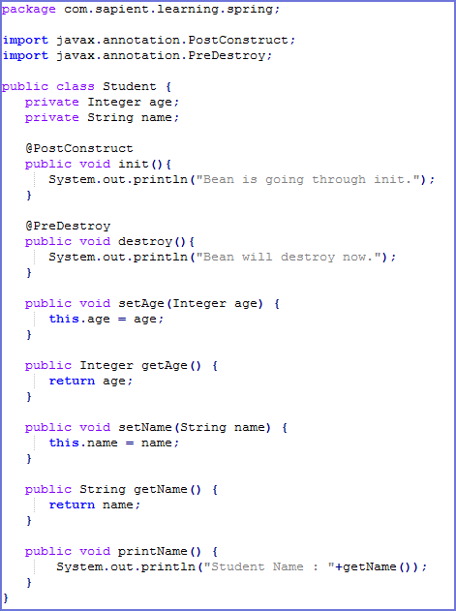
@PostConstruct and @PreDestroy annotations
Spring 2.5 onwards, you can use annotations also for specifying life cycle methods using @PostConstruct and @PreDestroy annotations.
@PostConstruct annotated method will be invoked after the bean has been constructed using default constructor and just before it’s instance is returned to requesting object.
@PreDestroy annotated method is called just before the bean is about be destroyed inside bean container.
Student.java

Slide 43
Exercise
In the Student application created earlier define student and address bean as singleton and do a getBean multiple times in main application and check whether same bean is returned or not. Repeat the same by marking address bean as prototype and observe what happens.
Use InitializingBean and DisposableBean callback interfaces in student bean to display bean construction and display messages. Repeat the same using aware interfaces, custom init() & destroy() and @PostConstruct and @PreDestroy annotations.
Student.java

Slide 44
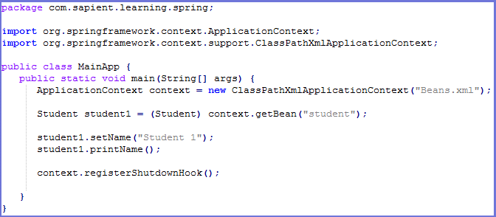
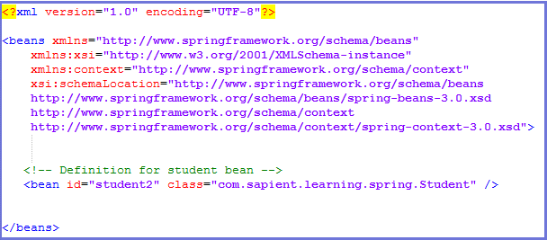
Bean Post Processors
The BeanPostProcessor interface defines callback methods that you can implement to provide your own instantiation logic, dependency-resolution logic etc.
You can also implement some custom logic after the Spring container finishes instantiating, configuring, and initializing a bean by plugging in one or more BeanPostProcessor implementations.
You can configure multiple BeanPostProcessor interfaces and you can control the order in which these BeanPostProcessor interfaces execute by setting the order property provided the BeanPostProcessor implements the Ordered interface.
An ApplicationContext automatically detects any beans that are defined with implementation of the BeanPostProcessor interface and registers these beans as post-processors, to be then called appropriately by the container upon bean creation.
MainApp.java
Beans.xml

Slide 45
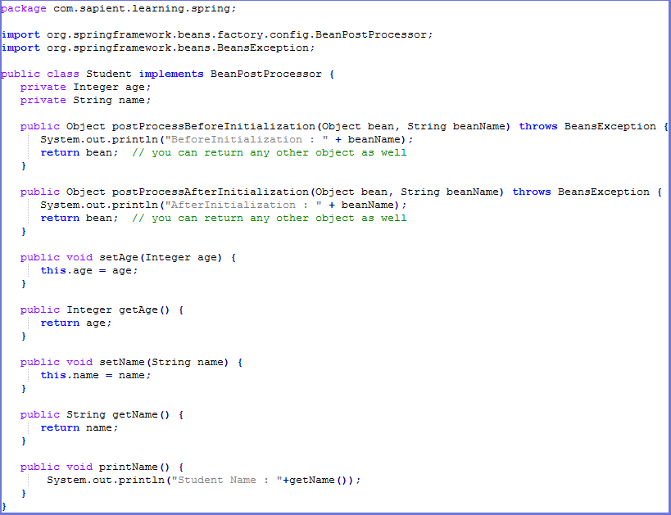
Bean Post Processors contd…
Student.java

Slide 46
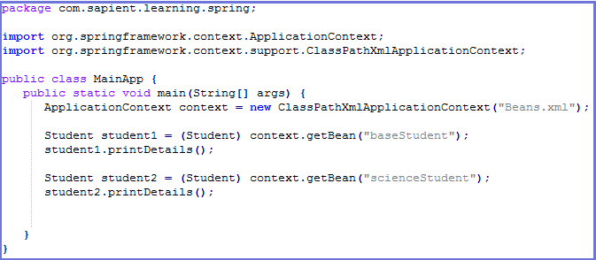
Bean Definition Inheritance
A bean definition can contain a lot of configuration information, including constructor arguments, property values, and container-specific information such as initialization method, static factory method name, and so on.
A child bean definition inherits configuration data from a parent definition. The child definition can override some values, or add others, as needed.
You can define a parent bean definition as a template and other child beans can inherit required configuration from the parent bean.
When you use XML-based configuration metadata, you indicate a child bean definition by using the parent attribute, specifying the parent bean as the value of this attribute.
MainApp.java

Slide 47
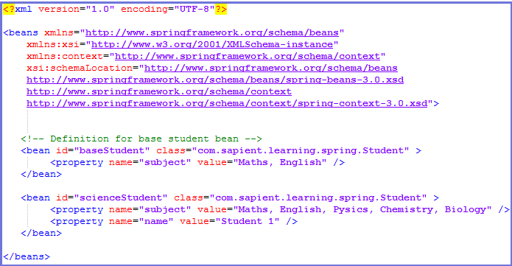
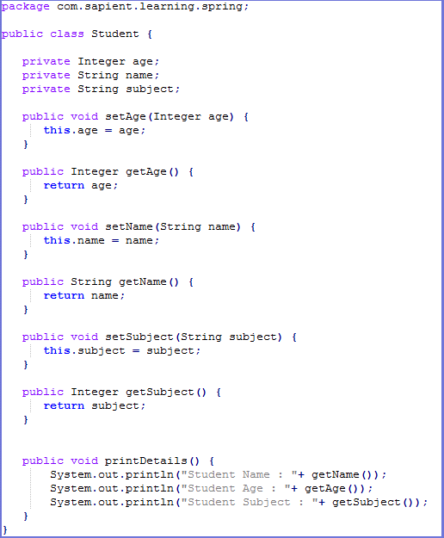
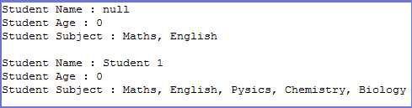
Bean Definition Inheritance contd…
Beans.xml
Student.java
Output

Slide 48
Exercise
Define a bean PostProcessor in the student bean and display student bean details in the callback methods.
Define an abstract bean student and extend it to have 3 children-ScienceStudent, CommerceStudent & ArtsStudent.
In the abstract bean define static properties like id, name, address etc.
In the child beans define stream specific fields for eg. in ScienceStudent define Physics, Chemistry, Maths as subjects.
Use Bean definition inheritance and display student details with/without overriding abstract bean definitions.

Slide 49
Dependency Injection
When writing a complex Java application, application classes should be as independent as possible of other Java classes to increase the possibility to reuse these classes and to test them independently of other classes while doing unit testing.
Dependency Injection (or sometime called wiring) helps in gluing these classes together and same time keeping them independent.
DI exists in two major variants in Spring :
Constructor-based dependency injection
Setter-based dependency injection

Slide 50
Constructor-based dependency injection
Constructor-based DI is accomplished when the container invokes a class constructor with a number of arguments, each representing a dependency on other class.
There may be a ambiguity while passing arguments to the constructor in case there are more than one parameters. To resolve this ambiguity, the order in which the constructor arguments are defined in a bean definition is the order in which those arguments are supplied to the appropriate constructor.
The container can also use type matching with simple types if you explicitly specify the type of the constructor argument using the type attribute.
You can also use the index attribute to specify explicitly the index of constructor arguments. Here the index is 0 based.

Slide 51
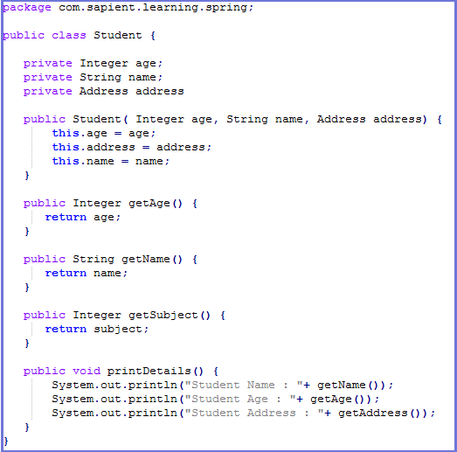
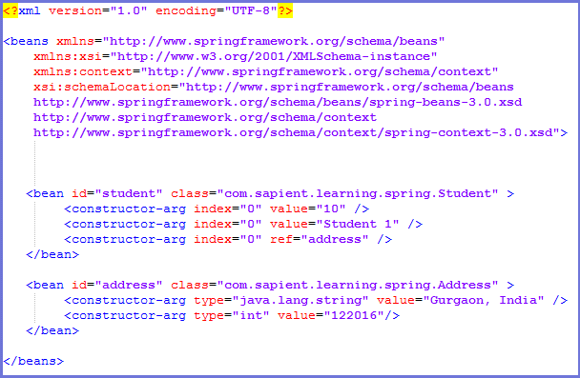
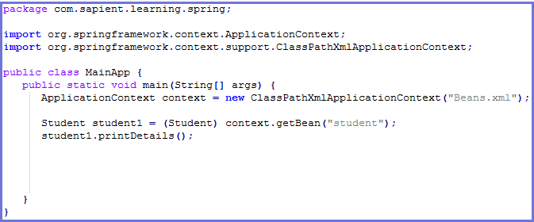
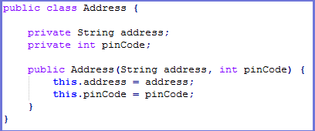
Constructor-based dependency injection contd…
Student.java
Beans.xml
MainApp.java
Address.java

Slide 52
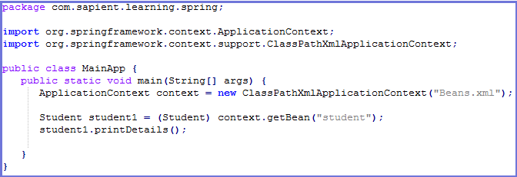
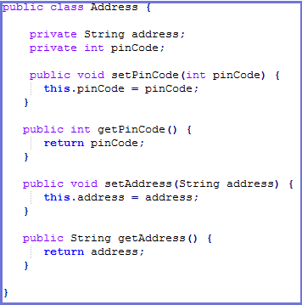
Setter-based dependency injection
Setter-based DI is accomplished by the container calling setter methods on your beans after invoking a no-argument constructor or no-argument static factory method to instantiate your bean.
In case you are passing a reference to an object, you need to use ref attribute of <property> tag and if you are passing a value directly then you should use value attribute.
MainApp.java
Address.java

Slide 53
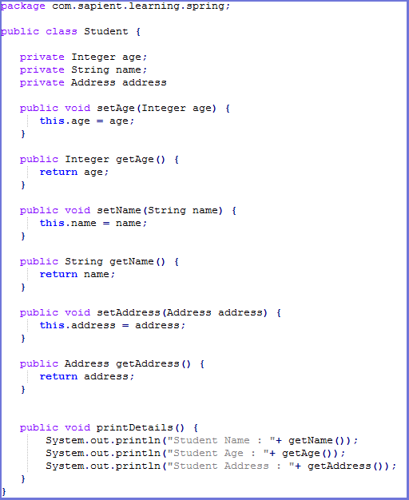
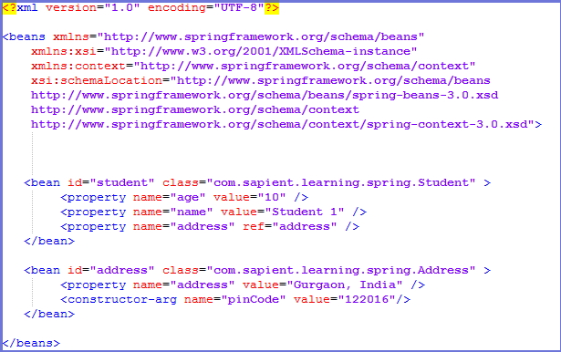
Setter-based dependency injection contd…
Student.java
Beans.xml

Slide 54
Exercise
Modify student bean created earlier to demonstrate constructor & setter based injection.
Include both injection techniques in the same bean and check which one is overridden.

Slide 55
Beans Auto-Wiring
The Spring container can autowire relationships between collaborating beans without using <constructor-arg> and <property> elements which helps cut down on the amount of XML configuration you write for a big Spring based application.
You use the autowire attribute of the <bean/> element to specify autowire mode for a bean definition. There are following autowiring modes which can be used to instruct Spring container to use autowiring for dependency injection :

Slide 56
Beans Auto-Wiring contd…
Mode | Description
no | This is default setting which means no autowiring and you should use explicit bean reference for wiring. You have nothing to do special for this wiring. This is what you already have seen in Dependency Injection chapter.
byName | Autowiring by property name. Spring container looks at the properties of the beans on which autowire attribute is set to byName in the XML configuration file. It then tries to match and wire its properties with the beans defined by the same names in the configuration file.
byType | Autowiring by property datatype. Spring container looks at the properties of the beans on which autowire attribute is set to byType in the XML configuration file. It then tries to match and wire a property if its type matches with exactly one of the beans name in configuration file. If more than one such beans exists, a fatal exception is thrown.
constructor | Similar to byType, but type applies to constructor arguments. If there is not exactly one bean of the constructor argument type in the container, a fatal error is raised.
autodetect | Spring first tries to wire using autowire by constructor, if it does not work, Spring tries to autowire by byType.

Slide 57
Autowiring 'byName'
This mode specifies autowiring by property name. Spring container looks at the beans on which auto-wire attribute is set to byName in the XML configuration file.
It then tries to match and wire its properties with the beans defined by the same names in the configuration file. If matches are found, it will inject those beans otherwise, it will throw exceptions.
MainApp.java
Address.java

Slide 58
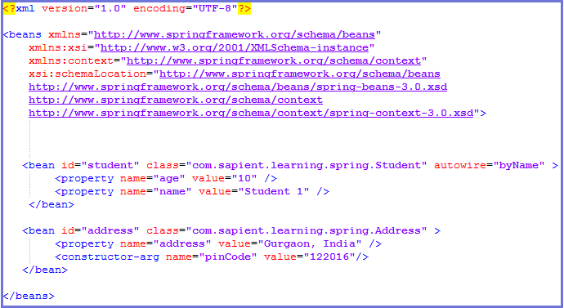
Autowiring 'byName‘ contd…
Student.java
Beans.xml

Slide 59
Autowiring 'byType'
Spring container looks at the beans on which autowire attribute is set to byType in the XML configuration file.
It then tries to match and wire a property if its type matches with exactly one of the beans name in configuration file. If matches are found, it will inject those beans otherwise, it will throw exceptions.
MainApp.java
Address.java

Slide 60

Autowiring 'byType‘ contd…
Student.java
Beans.xml

Slide 61
Autowiring by Constructor
This mode is very similar to byType, but it applies to constructor arguments.
Spring container looks at the beans on which autowire attribute is set to constructor in the XML configuration file. It then tries to match and wire its constructor's argument with exactly one of the beans name in configuration file.
If matches are found, it will inject those beans otherwise, it will throw exceptions.
MainApp.java
Address.java

Slide 62
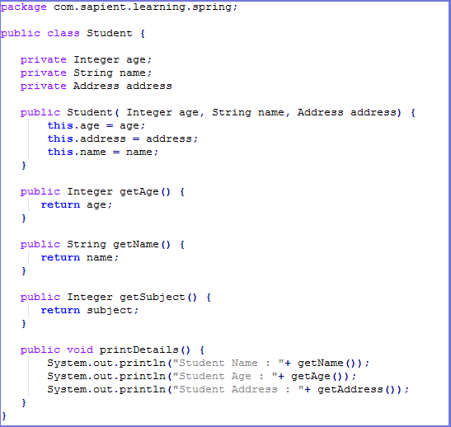

Autowiring by Constructor contd…
Student.java
Beans.xml

Slide 63
Circular Dependencies in Spring
As your Spring applications start to grow and become more complex you’re likely at some stage in your development process to come across a situation where two (or more) beans reference one another.
However, complications arise when you attempt to inject two beans into one another simultaneously i.e. inject Bean1 into Bean2 and Bean2 into Bean1.
An attempt to do this will often result in a circular dependency error resulting in something like:
org.springframework.beans.factory.BeanCreationException: Error creating bean with name ‘beanName’ defined in class path resource []:Cannot resolve reference to bean ‘beanName’ while setting bean property ‘beanName’; nested exception is org.springframework.beans.factory.BeanCurrentlyInCreationException: Error creating bean with name ‘beanName’: Bean with name ‘beanName’ has been injected into other beans [beanName2] in its raw version as part of a circular reference, but has eventually been wrapped (for example as part of auto-proxy creation).
The error is caused because Spring is trying to effectively inject two semi-initialized proxy beans into one another.
There are 3 possible technique for dealing with this problem :
Refactor your code
Extend ApplicationContextAware in your Bean(s)
Use a BeanPostProcessor

Slide 64
Circular Dependencies in Spring contd…
Refactor your Code
Look at your code, analyse why your two beans are referencing one another.
consider creating a third bean that both other beans can be injected into which will perform the functionality that requires the different dependencies.
refactor your design and simplify your structure
Extend ApplicationContextAware in your Bean(s)
Implement ApplicationContextAware interface in one of the beans causing your circular dependency problem. Implementing this interface will force you to provide a setter in your class for a Spring ApplicationContext.
One of the neat things with this though, is that Spring will detect that your bean has implemented ApplicationContextAware and automatically inject a reference to the ApplicationContext into your bean without you having to manually configure injection of the property in your xml bean definition.
Once you have setup your bean (say Bean1) as above, the next task is to stop injecting a reference to Bean2 into it. We just need to remove the reference to Bean2 from Bean1’s bean definition and thus remove the circular dependency problem.
The last thing to do is to look up Bean2 from the ApplicationContext programmatically at run-time.

Slide 65

Circular Dependencies in Spring contd…
Extend ApplicationContextAware in your Bean(s) contd…

Slide 66
Circular Dependencies in Spring contd…
Use a BeanPostProcessor
create a bean that extends Spring’s BeanPostProcessor interface and use this to initialise any of the properties in beans that cannot be initialised using IoC due to circular dependancy problems.

Slide 67
Exercise
Modify student bean to autowire the field references using different autowire strategies-byname, byType & constructor.
Include all in the same bean and check which one takes priority.
Include a cyclic dependency and see the Exception.
Debug it using ApplicationContextAware & BeanPostProcessor.

Slide 68
Injecting Inner Beans
inner beans are beans that are defined within the scope of another bean.
a <bean/> element inside the <property/> or <constructor-arg/> elements is called inner bean and it is shown below :
MainApp.java
Address.java

Slide 69

Injecting Inner Beans contd…
Student.java
Beans.xml

Slide 70
Injecting Collections
Spring offers four types of collection configuration elements which are as follows:
You can use either <list> or <set> to wire any implementation of java.util.Collection or an array. You will come across two situations :
Passing direct values of the collection and
Passing a reference of a bean as one of the collection elements
Element | Description
<list> | This helps in wiring ie injecting a list of values, allowing duplicates.
<set> | This helps in wiring a set of values but without any duplicates.
<map> | This can be used to inject a collection of name-value pairs where name and value can be of any type.
<props> | This can be used to inject a collection of name-value pairs where the name and value are both Strings.

Slide 71



Injecting Collections contd…
Beans.xml
Student.java
MainApp.java

Slide 72

Injecting bean references
If you want to inject bean references then use the ref element :
Beans.xml

Slide 73

Merging collections
According to the need, we can merge collection data while creating bean.
There will be a parent and child bean. Child will inherit the parent data.
It is done by the attribute merge="true".
This attribute is available in all collection tags like <list/>, <set/>, <map/> and <props/> .
Beans.xml

Slide 74



Merging collections contd…
MainApp.java
Student.java
Output

Slide 75
Exercise
Inject address bean as in inner bean in student.
Inject address bean as a collection in student bean. Inject it using list, set & map.
Use merge option and check whether collection is merged or not.

Slide 76
Event Handling in Spring
The ApplicationContext publishes certain types of events when loading the beans. For example, a ContextStartedEvent is published when the context is started and ContextStoppedEvent is published when the context is stopped.
Event handling in the ApplicationContext is provided through the ApplicationEvent class and ApplicationListener interface.
if a bean implements the ApplicationListener, then every time an ApplicationEvent gets published to the ApplicationContext, that bean is notified.
Spring provides the following standard events:
S.N. | Spring Built-in Events & Description
1 | ContextRefreshedEvent This event is published when the ApplicationContext is either initialized or refreshed. This can also be raised using the refresh() method on the ConfigurableApplicationContext interface.
2 | ContextStartedEvent This event is published when the ApplicationContext is started using the start() method on the ConfigurableApplicationContext interface. You can poll your database or you can re/start any stopped application after receiving this event.
3 | ContextStoppedEvent This event is published when the ApplicationContext is stopped using the stop() method on the ConfigurableApplicationContext interface. You can do required housekeep work after receiving this event.
4 | ContextClosedEvent This event is published when the ApplicationContext is closed using the close() method on the ConfigurableApplicationContext interface. A closed context reaches its end of life; it cannot be refreshed or restarted.
5 | RequestHandledEvent This is a web-specific event telling all beans that an HTTP request has been serviced.

Slide 77




Event Handling in Spring contd…
MainApp.java
Student.java
Beans.xml
Output

Slide 78


Custom Events
Event publishing is one of the capabilities provided by ApplicationContext.
There are a few simple guidelines to follow:
the event should extend ApplicationEvent
the publisher should inject an ApplicationEventPublisher object
the listener should implement the ApplicationListener interface
Spring allows to create and publish custom events which – by default – are synchronous. This has a few advantages – such as, for example the listener being able to participate in the publisher’s transaction context.
The publisher constructs the event object and publishes it to anyone who’s listening.
The only requirement for the listener is to be a bean and implements ApplicationListener interface.
CustomEventPublisher.java
CustomEvent.java

Slide 79


Custom Events Use Case
The use case for custom events is the same that we have been using throughout this tutorial- a student bean
Whenever a new student bean is requested from IOC container, a custom event is published
The files are :
StudentEvent.java : custom student event which extends ApplicationEvent and stores the student bean that was created
StudentEventPublisher.java : publishes StudentEvent whenever student bean is created
StudentEventHandler.java : Listens to StudentEvent and can do processing on Student object
Student.java : Student POJO
MainApp.java : gets student bean and publishes StudentEvent
Beans.xml : Spring configuration
StudentEventHandler.java
Student.java

Slide 80




Custom Events contd…
Beans.xml
StudentEvent.java
StudentEventPublisher.java
MainApp.java

Slide 81
Disadvantage of Spring
In the early days of Spring, it offered a simpler programming model compared to ejb 2.0. Today that advantage is gone. The JEE spec has evolved and easier to use.
there are no specs when it comes to Spring. Just one company engineering a framework.
Spring can do a lot, integrate with a lot of frameworks, but getting to know all the options requires time.
One of the major criticisms faced by the Spring framework is that it is complex! No so clear focus, more than 2400 classes, 49 other tools and tons of the other things make it complicated for the developers.

Slide 82
Recap
Basic understanding of Spring framework.
Working of Spring container and inversion of Control(IOC)
Spring Beans configuration
Bean Scopes
Dependency Injection
Event Handling
Disadvantages of Spring

Slide 83
References
docs.spring.io/spring/docs/current/spring-framework-reference/html/beans.html
www.tutorialspoint.com/spring/spring_dependency_injection.htm
https://www.mkyong.com/spring/spring-dependency-injection-di/
www.javatpoint.com/dependency-injection-in-spring
howtodoinjava.com › Spring › Spring Core
www.vogella.com/tutorials/SpringDependencyInjection/article.html
javapapers.com/spring/dependency-injection-di-with-spring/

Slide 84
THANK YOU

